Slide 1
SAP HANA ADMINISTRATON 2.0

Slide 2
Introduction of SAP HANA

Slide 3
Course Topics
What is SAP HANA
SAP HANA Database Architecture
SAP HANA Sizing
SAP HANA Persistence Layer
SAP HANA Scenarios
SAP HANA Studio
Modelling

Slide 4
What is SAP HANA
SAP HANA – High Performance ANalytic Appliance
SAP HANA is a solution for IN MEMORY COMPUTING.
It’s a technology that processes massive quantities of real-time data in the main memory of the server to provide immediate results from analysis and transactions.
Approximately 90% of SAP HANA is written in C++ coding.

Slide 5
SAP HANA is a technology platform for the new generation of SAP!
SAP HANA is the latest ERP Solution from SAP, which is a combination of Hardware and Software.
SAP HANA is an innovative columnar store in-memory database and data management platform, specifically developed to take full advantage of the capabilities provided by modern hardware to increase application performance. By keeping all relevant data in main memory (RAM), data processing operations are significantly accelerated.
The key performance indicators of SAP HANA appeal to many customers, and hundreds of deployments are in progress. SAP HANA has become the fastest growing product in SAP’s 40-year history.
SAP HANA can be deployed on-premise or cloud.

Slide 6
Two main components are available for the users:
1. A relational database management system (RDMS)
SAP HANA Database is a hybrid in– memory database. SAP HANA Database is the heart of SAP in-memory technology. In SAP HANA, Database table are of two types (Row Store & Column Store)
2. A development platform and application server
SAP HANA Platform is a development platform with an in-memory data store which allows the customers to analyze a large volume of data in real time. SAP HANA Platform works as a development platform, which provides infrastructure and tools for building a high-performance application based on SAP HANA Extended Application Services (SAP HANA XS).

Slide 7
There are different types of SAP HANA edition, some of them as below
SAP HANA Platform Edition – It provides Core database technology. It Integrate SAP component like SAP HANA database, SAP HANA Studio and SAP HANA clients. It is for customers who want to use ETL-based replication and already have a license for SAP Business Objects Data Services.
SAP HANA Enterprise Edition – It contains data provisioning (SLT, BODS, DXC) component including core database technology. It is for customers who want to use either trigger-based replication or ETL-based replication and do not have all of the necessary license for SAP Business Objects Data Services.
SAP HANA Extended Edition – It contains data provisioning (Sybase) features more than Platform and Enterprises edition. It is for customers who want to use the full potential of all available replication scenarios including log-based replication.

Slide 8
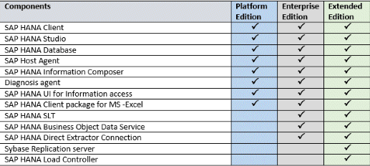
Below diagram shows difference between all these editions.

Slide 9
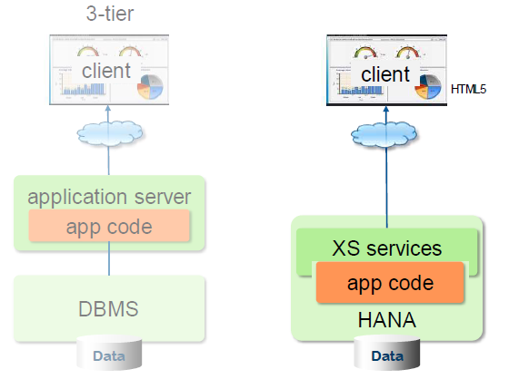
Traditional 3-tier applications (Java, ABAP) vs. native SAP HANA applications

Slide 10
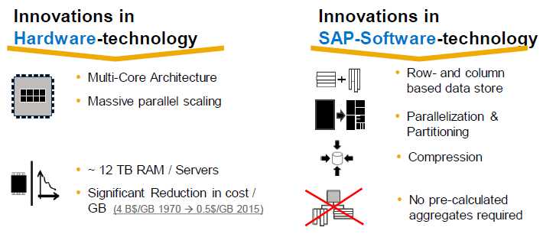
How Did SAP HANA Become Possible?
SAP HANA’s strength comes from innovations in hardware and software
Important to understand them for understanding performance

Slide 11
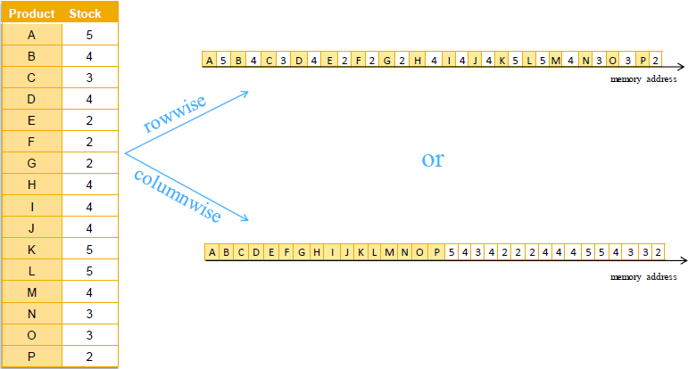
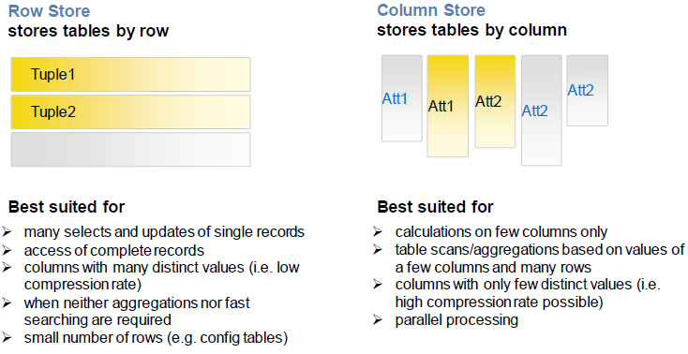
Row Store Vs Columnar Store

Slide 12
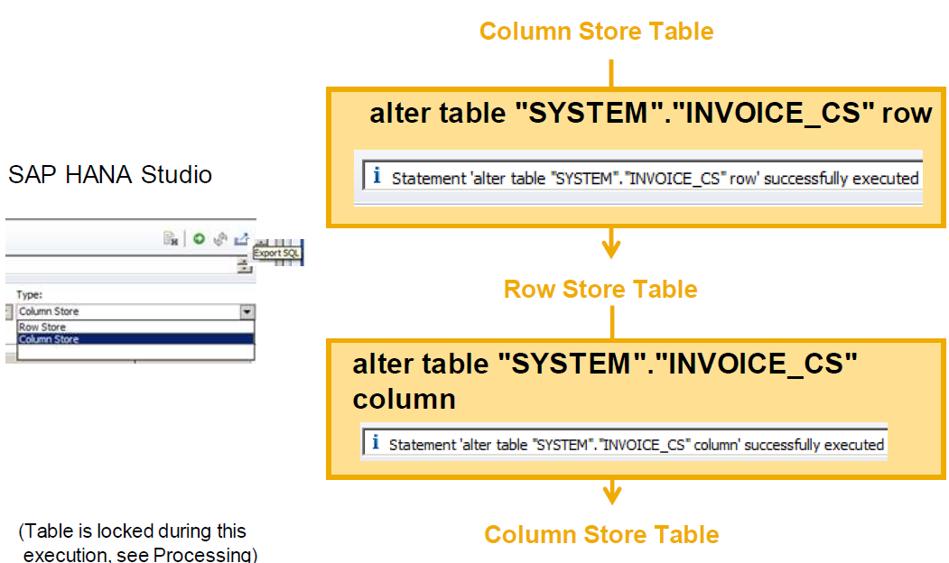
Row & Column Store Table Conversion (Column Table ↔ Row Table)

Slide 13
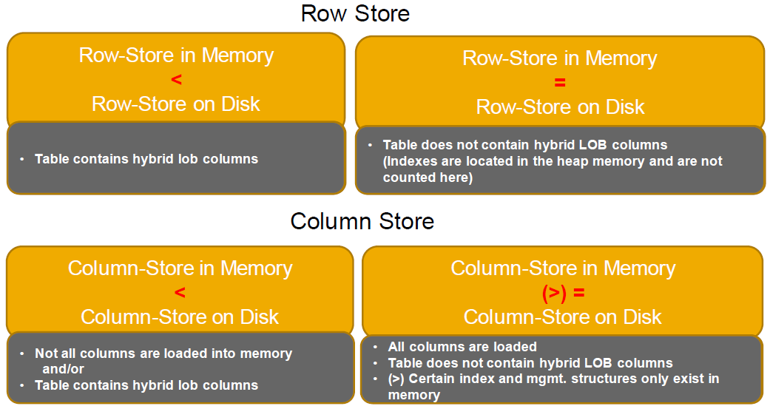
Row & Column Store Memory vs. Disk
The size of a table in memory and on disk need not to be the same:

Slide 14
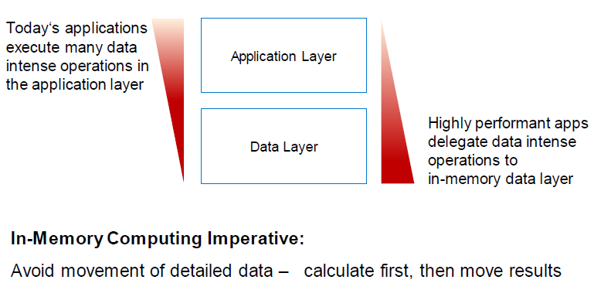
Delegation of data intense operations to the in-memory data layer

Slide 15
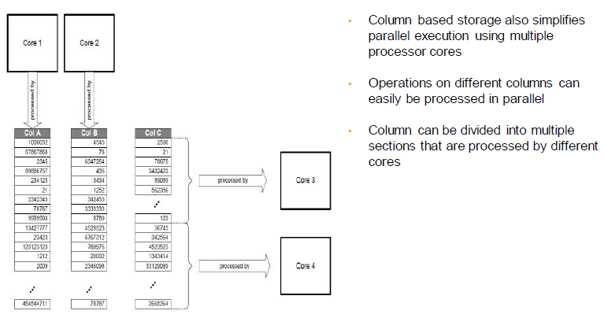
Parallelization

Slide 16
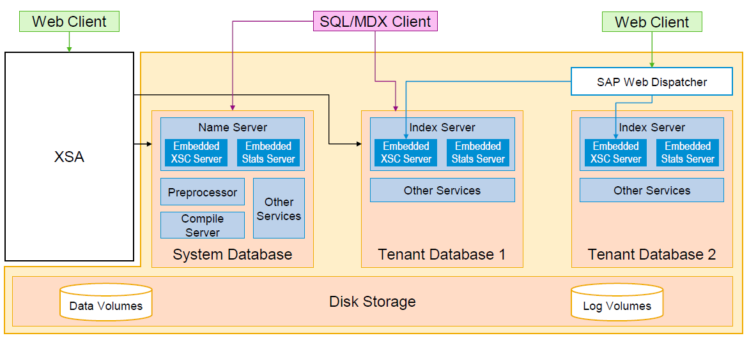
SAP HANA Architecture Single host configured as multi-tenant database container

Slide 17
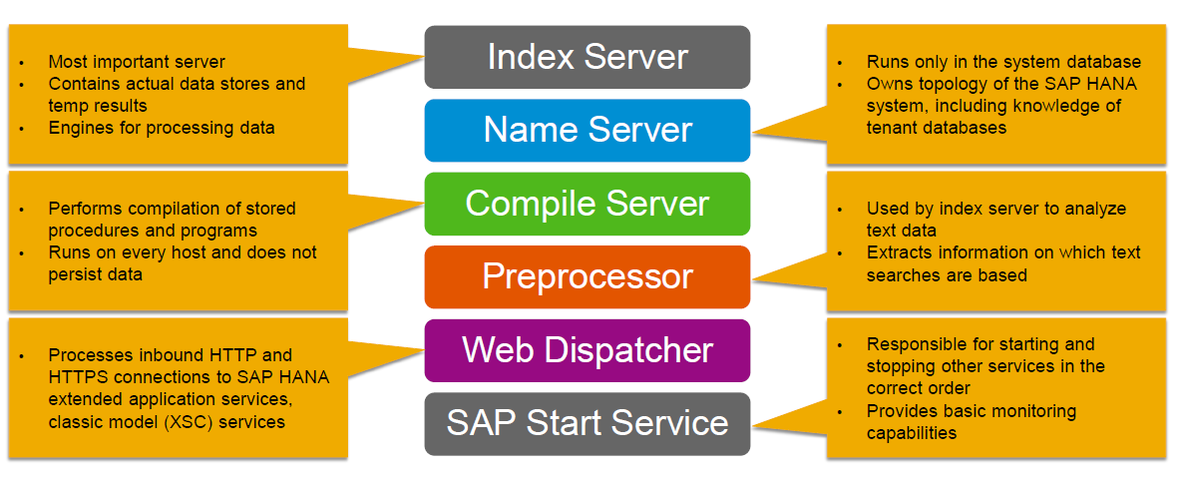
SAP HANA Architecture Core Services

Slide 18
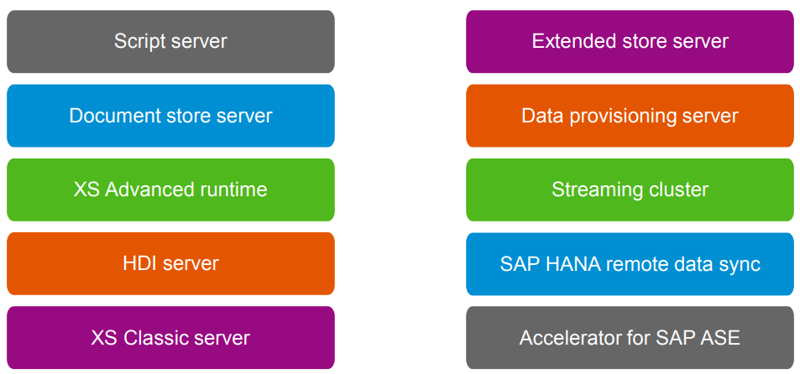
SAP HANA Architecture Optional Services

Slide 19
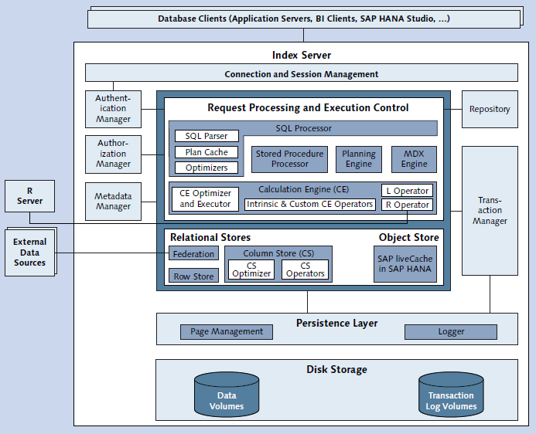
Index Server internal architecture
It's the main SAP HANA database component
It contains actual data stores and the engine for
processing the data.
Index Server processes incoming SQL or MDX
statement.

Slide 20
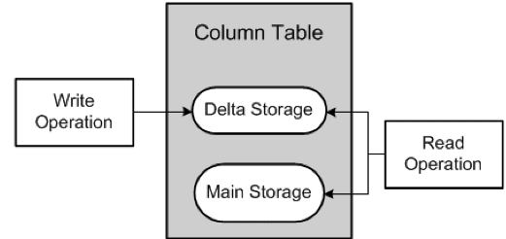
Main and Delta Storage
To fit as much data as possible in memory the in memory data has to be compressed
• Writing into highly compressed data is too slow since
then it needs to be re-compressed after each write
• Additionally sorted dictionary optimizes read access
Column Store divides each columns into two parts:
Delta: Less Compressed, Write Optimized, Not Sorted Dict.
Main: Very Compressed, Read Optimized, Sorted Dictionary
This enables high compression and high write performance at the same time
High compression - To keep all relevant application data in memory
High write performance – Insert only in delta storage Storage

Slide 21
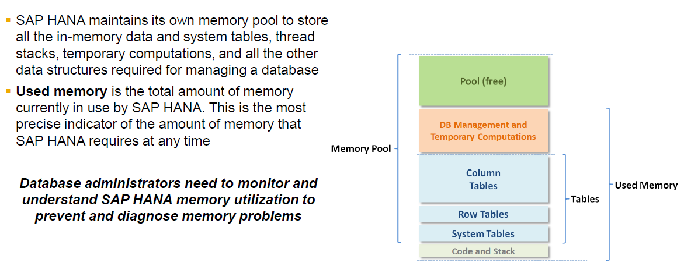
SAP HANA Architecture SAP HANA memory usage

Slide 22
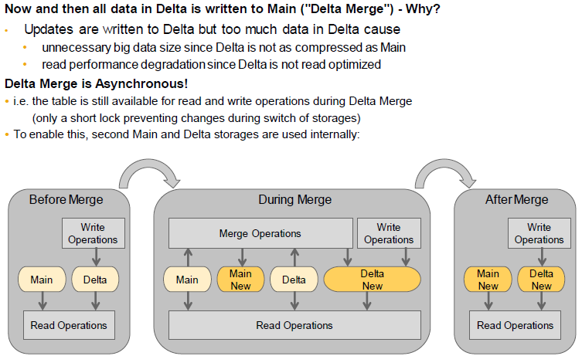
Delta Merge

Slide 23
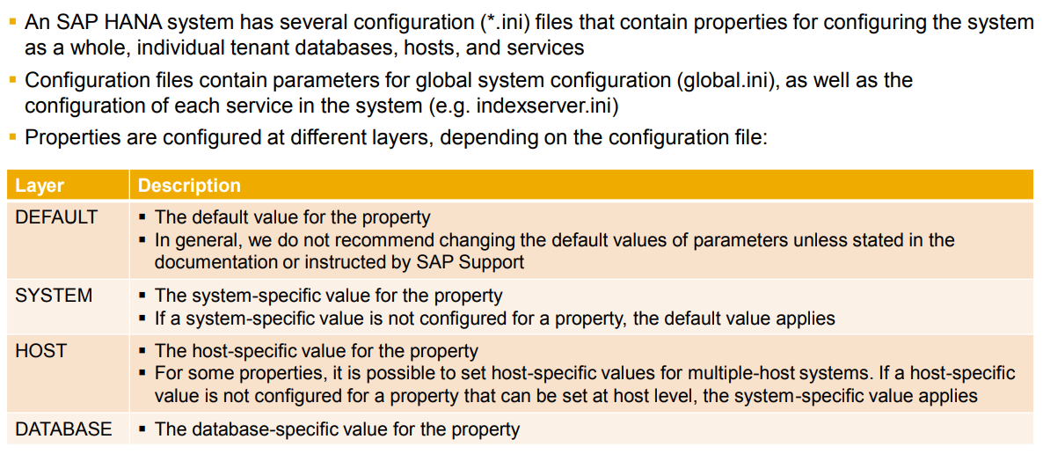
SAP HANA Architecture Properties

